Slide 1


Presentation
HOME CREDIT DEFAULT RISK MODELING SERVICE
QINGYUAN WANG, SIYUAN WANG, FLORENCE WANG, ZIFAN QIAN, RICHARD PAN

Slide 2


Presentation
Context
03
Hypothesis
06
Data
08
Model
10
Results
13
Explainability & Validity
15
Conclusion & Next Steps
16
02
/
10

Slide 3

Presentation
Context
Problem Setting
• Applicants often lack traditional credit history.
• Objective: rank default-risk probability to support approve/review/decline decisions.
• Constraint: strong class imbalance (~8.07% defaults) and governance requirements.
Business KPI
• Improve expected loss control while preserving approval throughput.
04
/
10

Slide 4
Presentation
Context
Business Value
• Better ranking reduces credit losses and improves pricing/limit decisions.
• Explainable outputs support analyst review and model governance.
Assumptions (Planning Scenario)
• 100K applications/year, 60% approval rate, baseline default 6%, LGD 45%.
Estimated Annual Savings
• Conservative: $0.52M • Moderate: $0.84M • Upside: $1.17M.
05
/
10

Slide 5

Presentation
Hypothesis
Predictable Outcome
• Applicant + aggregated credit-history features provide signal above random ranking.
Statistical Hypothesis
• H0: ROC-AUC ≤ 0.50 (chance-level ranking).
• H1: ROC-AUC > 0.50 (useful ranking signal).
Error Types & Business Impact
• Type I (FP): good borrower flagged high-risk → lost approvals/revenue.
• Type II (FN): risky borrower flagged low-risk → defaults/write-offs.
Error Type | Definition | Business Impact
Type I (False Positive) | Classify reliable borrower as high risk | Lost revenue, reduced acquisition, fairness concerns
Type II (False Negative) | Classify high-risk borrower as low risk | Elevated defaults, write-offs
06
/
10

Slide 6
Presentation
Hypothesis
Governance
• Threshold policy balances Type I vs Type II cost trade-offs.
Hypothesis Testing Strategy
• Stratified 80/20 train-validation split (class ratio preserved).
• Primary metric: ROC-AUC (threshold-independent, imbalance-robust).
• Early stopping on validation AUC to reduce overfitting.
Threshold Logic
• Default threshold: 0.50 (policy lever, not training objective).
• Recommend expected-value threshold tuning + 5-fold stratified CV next.
07
/
10

Slide 7
Data
Presentation
Content | Source | Rows | Columns
Main table with target | application_train.csv | 307,511 | 122
Credit bureau history | bureau.csv | 1,716,428 | 17
Monthly bureau status | bureau_balance.csv | 27M | 3
Prior applications | previous_application.csv | 1.67M | 37
POS/cash loan monthly | POS_CASH_balance.csv | 10M | 8
Payment history | installments_payments.csv | 13.6M | 8
Card monthly balances | credit_card_balance.csv | 3.84M | 23
5.2 Data Acquisition + Integrated Dataset
• Sources: application_train/test, bureau, bureau_balance, previous_application,
POS_CASH_balance, installments_payments, credit_card_balance.
• Scale: ~58M+ source rows merged to 307,511 applicant-level rows.
Feature Engineering (5.4)
• Ratios: CREDIT_INCOME_RATIO, ANNUITY_INCOME_RATIO, CREDIT_ANNUITY_RATIO, DAYS_EMPLOYED_PCT.
• Aggregates by SK_ID_CURR: mean/max/min/sum/std/count per source table.
08
/
10

Slide 8
Presentation
Data
5.3 Data Exploration + 5.4 Data Preparation
Before
• 41 columns in application_train with >50% missingness; highest ~69.9%.
• Class imbalance: TARGET=1 is 24,825 / 307,511 (8.07%).
After
• Applicant-level consolidated frame with historical aggregates and engineered ratios.
• Cleaning: DAYS_EMPLOYED=365243 → NaN; numeric coercion; missing-category token.
• Imbalance handling: LightGBM scale_pos_weight = negatives/positives.
09
/
10

Slide 9


Presentation
Model
Model Type & Approach (5.9.4)
• Learning type: Supervised learning.
• Task: Binary classification (default vs non-default).
• Algorithm: LightGBM gradient boosting classifier.
• Pipeline: preprocessing (encoding/imputation/coercion) → estimator.
• Goal: maximize ranking quality for risk-based decision policy.
10
/
10

Slide 10

Presentation
Model
Modeling Approach, Split, and Evaluation
• Phases: baseline setup → weighted model → candidate focal-loss comparison.
• Split strategy: stratified 80/20 (Train: 246,008; Validation: 61,503).
• Primary metric: ROC-AUC; secondary: precision/recall at policy thresholds.
• Benchmark: random ranking AUC = 0.50.
• Validation emphasizes ranking robustness under class imbalance.
12
/
10

Slide 11
Presentation
Methodology
Training Methodology
• Preprocessing: categorical encoding with __MISSING__, numeric coercion, sentinel cleaning.
• Imbalance strategy: scale_pos_weight (~11.39) applied in LightGBM.
• Regularization: subsample/colsample + L1/L2 with fixed random seed (42).
• Overfitting control: early stopping on validation ROC-AUC.
• Full configuration and metrics stored in artifacts/training_report.json.
11
/
10

Slide 12


Presentation
Results
Results Summary (5.9.5)
• Validation ROC-AUC: 0.7893
• Train ROC-AUC: 0.8936
• Baseline (random): 0.5000
• Absolute lift over baseline: +0.2893
Interpretation: strong ranking separation for risk triage.
03
/
10

Slide 13

Presentation
Results
Model Performance Across Phases
• Baseline benchmark (random): AUC 0.5000
• Final selected model (scale_pos_weight): Validation AUC 0.7893
• Candidate focal-loss model: Validation AUC 0.7886
• External SOTA under identical data/pipeline is not directly available; comparison uses internal baselines.
Operational Policy Mapping
• Low risk (p < 0.30): approve standard terms
• Medium risk (0.30–0.70): human validation
• High risk (p > 0.70): decline or stricter conditions
13
/
10

Slide 14
Presentation
Explanation
Local Explanation (Per Applicant)
• Method: LightGBM pred_contrib=True in service.py.
• Returns: top_contributors + base_value + final probability.
• Meaning: each feature contribution pushes risk up or down additively.
Business Use
• Transparent case-by-case decisions for underwriting analysts.
• Easier exception handling, auditability, and reviewer trust.
• Supports explainable approve/review/reject workflows.
14
/
10

Slide 15
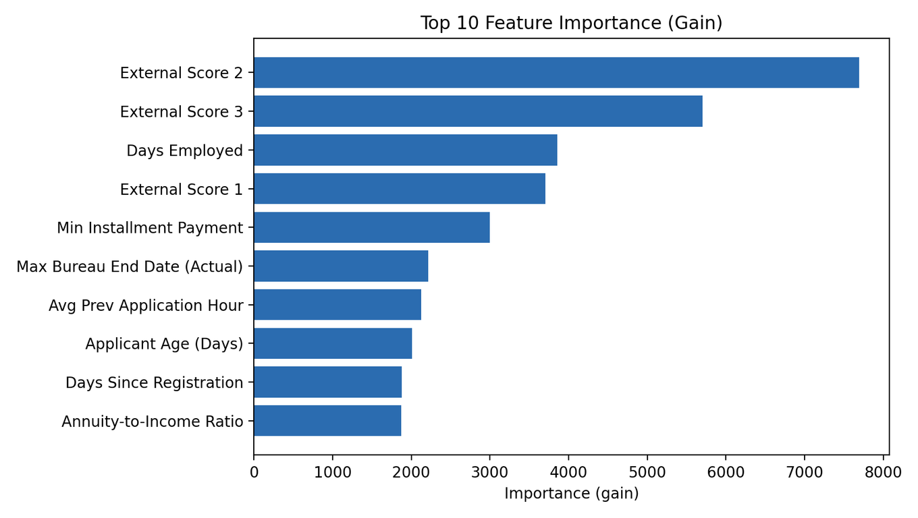
Explanation
Presentation
Global Explanation (Portfolio Level)
• Feature importance generated during training (gain + split).
• API exposure: GET /feature-importance?limit=N.
• Output: ranked drivers for monitoring model behavior over time.
Governance Value
• Detect drift via feature-importance shifts across retrains.
• Validate alignment with business logic and risk policy.
• Support model risk management and regulatory communication.
14
/
10

Slide 16
Presentation
Threats to Validity
Threats to Validity (5.9.7)
• Data leakage risk: historical aggregates may include post-decision information if not time-aligned.
• Drift risk: macro/policy changes can shift applicant distributions and outcome rates.
• Missingness risk: sparse fields and unknown categories may degrade generalization.
• External validity: performance may not transfer to different lenders/geographies.
• Uncertainty: current evaluation is single holdout; add 5-fold CV for confidence intervals.
15
/
10

Slide 17
Presentation
Conclusions
Conclusions (5.9.8)
• Final model delivers strong ranking signal (Validation AUC 0.7893 vs 0.500 baseline).
• Suitable for risk-band policy to reduce losses while preserving throughput.
Deployment Readiness
• API endpoints for health, prediction, metadata, and feature importance.
• Local decision UI available: uv run run-homecredit-local-app.
Business Recommendation
• Adopt in decision-support mode with human review in medium-risk band.
• Estimated annual savings potential: $0.52M–$1.17M (assumption-based).
Decision Implication
• Proceed to controlled rollout with monitoring and policy simulation.
• If deferred, expected opportunity cost remains in avoidable defaults.
16
/
10

Slide 18
Presentation
LESSONS LEARNED
& NEXT STEPS
• Multi-source aggregation materially improves ranking quality.
• Cost-sensitive policy rules are essential; model score alone is not enough.
• Add 5-fold stratified CV and probability calibration before broader rollout.
• Add fairness, drift, and stability monitoring in production governance.
• Enhance local desktop app with scenario simulation for underwriting teams.

